Slide 1

Team Loyalty – Project Proposal Presentation
CSCE 5430.004 (Spring 2023)

Slide 2
eCommerce Loyalty Stack Team Loyalty
Student Name | GitHub Username | Role
Bradley Davis (Leader) | lightsixer | Design Lead, Implementation Lead (Back End), DBA
Tyler Parks | Tyler Parks | Requirements Lead, Demo and Presentation Lead
Sandy Martinez-Echegoyen | sandymarech | Project Manager, Implementation Lead (Front End)
Vishpendra Chahar | Vishpendra Chahar | Testing Lead, Documentation Lead
Rama Reddy Venkata | ramatvrr14 | Configuration Management Lead, System Administrator
Team Members

Slide 3
Project Description
Group: Team Loyalty
Project Description:
An implementation of a working commercial enterprise loyalty stack, integrated into a mock eCommerce application site. The main UI and customer experience will be a conventional Internet shopping website, selling a range of products yet to be determined.
Examples (...think): An Amazon-like storefront with a layered loyalty program. This layered program would resemble services like Airlines with travel miles or rewards-based store purchases.

Slide 4
Core Behaviors
Baseline set of product features for a minimum viable product (MVP).
Customers will register a Loyalty Account with their personal information
Collects customer PII data
Establish a set of secure personal login credentials
authenticated access to the customer’s profile
Profile management after creation
updating or adding personal information
Loyalty System will need to establish a primary identifier (ID) for the loyalty customer
Track enrollment status of a Loyalty Account and date of registration
active, closed, and other options
Customers will have the ability to earn Loyalty Points for their eCommerce purchases
Rules-based engine
implementing this will be a critical component of the project
Earn a fixed number of base points per eligible dollar spent

Slide 5
Core Behaviors (cont.)
"Bonus": Adding promotional and customer incentives
threshold-based (spend $50, receive 1000 extra points)
point multipliers (receive 2X points on product XYZ)
Customer’s ability to redeem points for something of value; "a reward"
Reward, discount, certificate, or coupon
redeemed as a discount in their basket on next purchase
Redeem from a catalog of physical and digital redemption items
Special-banner/loyalty-status on page/dashboard for
signed-up members
Account Data
metadata
membership (card) number
status (active, elite status or a higher tier based on spend threshold)
current available points balance
The point balance is critical and non-trivial to implement
Points earned
Points deducted for redemptions
Accuracy of points balances
History of their own purchase transactions

Slide 6
Stretch Goals and Optional Ideas
Many of these goals may prove unlikely or unrealistic for a single semester project. There are numerous optional capabilities to create a much more enhanced loyalty product.
Blockchain/Crypto wallets, Tokens/NFTs
Loyalty Tiers
Surveys, Quizzes, Polls
Badges, Avatars
Gamification
Social Media integration, Account Linking, Mobile App
Points Pooling, Points Transfer, Gifting
Program Admin UI
Call Center, Enrollment/Welcome bonus, Email communications
Reporting

Slide 7
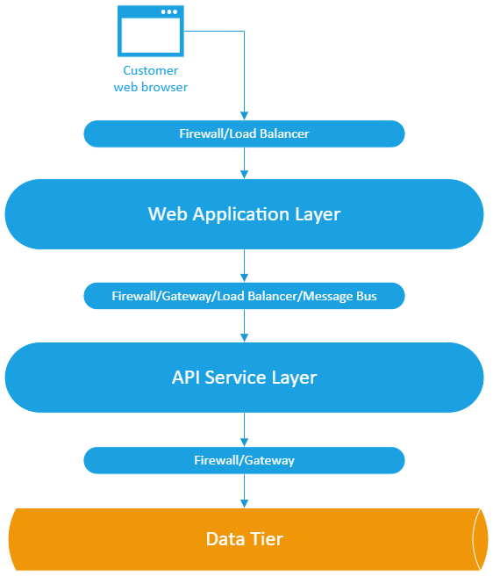
Technology and Implementation
We will implement the Loyalty Stack project as an N-tier architecture.
Most conventional approach with a closed layer architecture
Each layer can only communicate with the next layer immediately down the stack
Data Layer
Lowest layer and Highly protected
Storing and providing authenticated access to the application’s data
Application layer
Several infrastructure-oriented component layers
Services buses
Message queues
Caches
Presentation layer
One or more user-facing applications

Slide 8

Web Application Layer
Some of our team members are already experienced in React.
Others should hopefully find it an approachable and valuable learning opportunity.
Front End! -- a mock eCommerce web site
JavaScript
Language of the Web and React
Very popular and well-established framework for component-based development of Web experiences
Dynamic
Runs at relatively high speed in modern web browsers and features a C-like syntax
HTML5 and CSS3
React framework, running on Node.js
React-based eCommerce framework
Key elements will be implemented as custom React components

Slide 9
Service Layer
To create loyalty capabilities for our eCommerce web application, we will implement a set of RESTful APIs in the service layer.
Implementation
Leverage HTTP verbs
JSON request/response payloads
Features
Provide APIs for the core capabilities and logic of the solution
Managing customer profiles
evaluating purchase transactions for the awarding of points
providing point and activity history, converting points to rewards
redeeming rewards and any other features that rely on business rules
CRUD operations
Language and Technology
The chosen service layer implementation language is Java
Spring Boot framework
Some basic security and access control
Java has a massive presence in industry software development

Slide 10
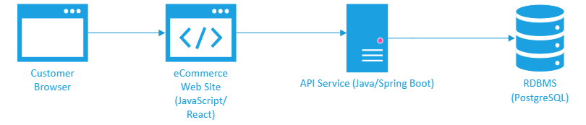
Data Layer
Using an ERD (Entity-Relationship Diagram) for our logical data model and then easily implement it in PostgreSQL with commonly available SQL tools and bind it to entities in our service layer.
The Data Layer will be implemented as a SQL-based RDBMS
PostgreSQL
Approachable
Ease of use
PostgreSQL
Free and open-source
Standard ACID capabilities

Slide 11
Platform and Deployment
Documentation and Source Control Platforms
GitHub ​
Kanban on Trello​
Project planning​
Tracking​
Management​
Microsoft Teams
Implementation Platforms
Virtualized Linux instance
Ubuntu-based OS
VSCode, VS
JetBrains IntelliJ IDEA
SQL Access and Database Administration​
PgAdmin​
DBeaver​

Slide 12
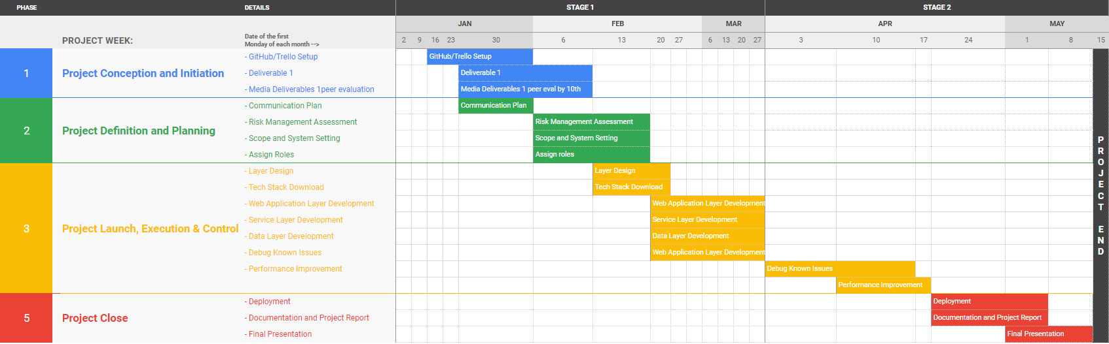
Planning – Timeline

Slide 13

Planning – Milestones
Milestone 1: Communication Plan
Milestone 2: Risk Management Assessment
Milestone 3: Scope and System Setting
Milestone 4: Assign Roles
Milestone 5: Layer Design
Milestone 6: Tech Stack Download
Milestone 7: Web Application Layer Development
Milestone 8: Service Layer Development
Milestone 9: Data Layer Development
Milestone 10: Debug Known Issues
Milestone 11: Performance Improvement
Milestone 12: Deployment
Milestone 13: Documentation and Project Report
Milestone 14: Final Presentation
2/1 – 2/20
Early –
Mid-February
2/20 - 4/20
Mid-February –
Mid-April
4/20 - 5/15
Mid-April
– Mid-May

Slide 14
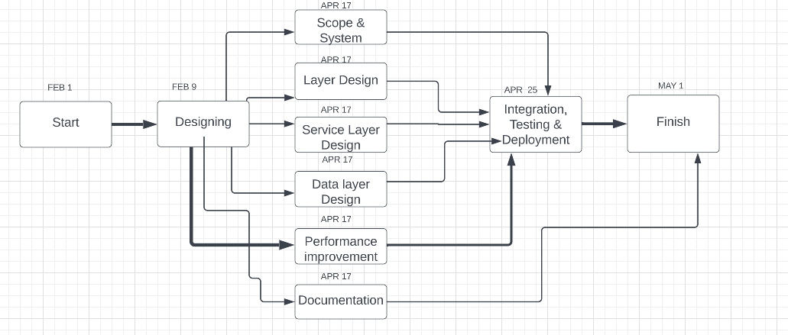
Planning - PERT Chart and Timeline

Slide 15
Risk Management – Top Risks
Over-extended Scope
Our group plans to execute and deliver a functional web storefront, layered with loyalty features; however, we also plan for scope constraints in that not all projected features and capabilities will be completed.
Learning Curve and Technical Challenges
Depending on the technologies we choose to build our project, our group takes the risks of performing on a shrunken timeline to make room for learning said new technologies.
Exceeding Budget ‘Hours’
As a group of five members, the raw number of hours we will be able to put into our project will be large, but possibility not large enough to complete the project in its entirety.

Slide 16
Risk Management – Monitoring
To monitor and mitigate risks to our milestones and overall project, each team member will need to keep track of a list of action items including:
Task Verification
Action Items
Pending items
Completed items
In-progress items
Team Member | Action Item | Date Due By | C/I/IP | Verified By
Member 2 | Create Project Plan | 2/10/23 | IP | Member 1
Member 2 | Build Website | 3/12/23 | IP | Member 3
Member 1 | Finish Website | 4/6/23 | IP | Member 3
... | ... | ... | ... | ...
This list will be created on a collaborative document so that each team member has access to each other member’s workflow.

Slide 17

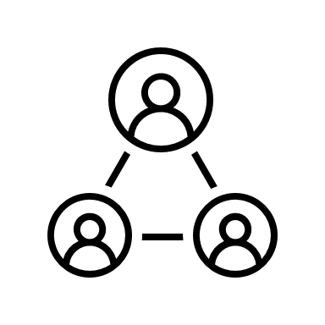

Risk Management – Reevaluation
Our group should be able to track how much and what work has been completed; as well as any action items that slipped through the cracks.
At each Major Milestone
Reassess and redefine current...
Risks
Objectives
Plans
Being able to track each team member’s contributions will enable each of us to reinforce each other’s work habits and ensure overall project completion.

Slide 18
Risk Management – Mitigation and Contingency Plans
Our group will need to take steps to secure our project in case of risk frution
Loss of a team member
Lack of contributions from one or more members
Timeline challenges
Scope issues
Addressing these issues
Each team member should assist in identifying the problem situation
Cooperate with other members to determine the best path forward
This might include splitting and distributing additional action items to finish the project on time

Slide 19
References
Github Link: https://github.com/lightsixer/loyalty-stack
Trello Board: https://trello.com/b/EJKI3Vdw/kanban

Slide 20
Thank You.

